Slide 1
Arrays in JAVA
Array is collection of related data items
Arrays in Java are containers or objects that store multiple values of the same type in a contiguous block of memory.
Practical uses of arrays-
  Sorting algorithm,stacks,queues,heaps etc.
  Storing a list of Data types.
  Iteration and asscessing elements
  Efficient data Storage,better performance
  Image processing,Gaming,Graphics.

Slide 2
Declaring an Array Variable
Do not have to create an array while declaring array variable
  <type> [ ] variable_name;
  Double[ ] myList;
  double myList[ ];
Both syntaxes are equivalent
No memory allocation at this point

Slide 3
Define an array as follows
  Using new DataType[arraySize];
  MyList = new int[10];
It assigns the reference of the newly created array to the variable variable_name.
dataType arrayname[ ] = {list of values};
Int a [ ]={1,2,3,4,5,6,7,};
Array index starts from 0 to arraySize-1;
Declaring and defining in the same statement
Double [ ] mylist = new double[10];

Slide 4
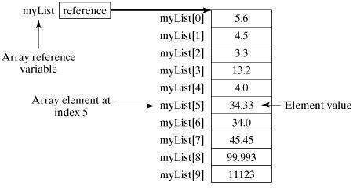
Creating arrays.....

Slide 5
Memory Utilization in Java arrays
Java manages memory automatically through garbage collection, handling memory deallocation for arrays and objects when they are no longer referenced.
Arrays in Java have a fixed size once created. The memory required for an array is calculated based on the number of elements and the data type of those elements.
.//Example
int[] intArray = new int[100]; // Allocates memory for 100 integers
// Memory utilized by this array: 100 * 4 bytes (assuming 32-bit integer) + overhead

Slide 6
Example for Accessing Array Elements
public class TestArray {
public static void main(String[] args) {
double[] myList = {1.9, 2.9, 3.4, 3.5};
// Print all the array elements
for (double element: myList) {
System.out.println(element);
}
}
}
Otput:
1.9
2.9
3.4
3.5

Slide 7
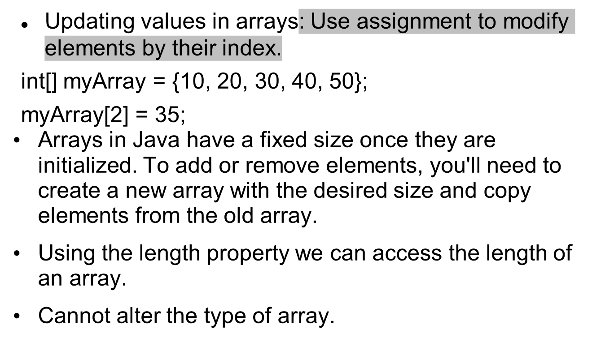
Modifying Array Elements

Slide 8
Multi-Dimensional array(Arrays of arrays)
Allow us to create tables of data, matrices, or other complex structures where data is organized in rows and columns.
Used in applications involving grids, matrices, databases, game boards, image processing, etc.
Two-Dimensional arrays--->
int[][] twoDArray = { {1, 2, 3}, {4, 5, 6}, {7, 8, 9} };
int element = twoDArray[1][2]; // Accessing the element at row 1, column 2 (value: 6)
for (int i = 0; i < matrix.length; i++) {
for (int j = 0; j < matrix[i].length; j++) { <--- Traversing a 2D Array
System.out.print(matrix[i][j] + " ");
} }

Slide 9
THANK YOU

